Slide 1
MODULE – I: CONCEPTUAL MODELING INTRODUCTION

Slide 2
Introduction of Data Bases
A database-management system (DBMS) is a collection of interrelated data and a set of programs to access those data.
A DBMS is a software system that is designed to manage and organize data in a structured manner. It allows users to create, modify, and query a database, as well as manage the security and access controls for that database.
The collection of data, usually referred to as the database, contains information relevant to an enterprise.
The primary goal of a DBMS is to provide a way to store and retrieve database information that is both convenient and efficient. Database systems are designed to manage large bodies of information.

Slide 3
Management of data involves both defining structures for storage of information and providing mechanisms for the manipulation of information.
In addition, the database system must ensure the safety of the information stored, despite system crashes or attempts at unauthorized access.
If data are to be shared among several users, the system must avoid possible anomalous results.
Because information is so important in most organizations, computer scientists have developed a large body of concepts and techniques for managing data.

Slide 4
Database-System Applications
Enterprise Information
Sales: For customer, product, and purchase information.
Accounting: For payments, receipts, account balances, assets and other accounting information.
Human resources: For information about employees, salaries, payroll taxes, and benefits, and for generation of paychecks.
Manufacturing: For management of the supply chain and for tracking production of items in factories, inventories of items in warehouses and stores, and orders for items.
Online retailers: For sales data noted above plus online order tracking, generation of recommendation lists, and maintenance of online product evaluations.

Slide 5
Banking and Finance
Banking: For customer information, accounts, loans, and banking transactions.
Credit card transactions: For purchases on credit cards and generation of monthly statements.
Finance: For storing information about holdings, sales, and purchases of financial instruments such as stocks and bonds; also for storing real-time market data to enable online trading by customers and automated trading by the firm.

Slide 6
Universities:
For student information, course registrations, and grades (in addition to standard enterprise information such as human resources and accounting).
Airlines:
For reservations and schedule information. Airlines were among the first to use databases in a geographically distributed manner.
Telecommunication:
For keeping records of calls made, generating monthly bills, maintaining balances on prepaid calling cards, and storing information about the communication networks.

Slide 7
Purpose of Databases
It is a collection of tools that enable users to create and manage databases. In other words, it is general-purpose software that allows users to create, manipulate, and design databases for a number of purposes.
Database systems are design to deal with large volumes of data. Data management comprises both the construction of data storage systems and the provision of data manipulation methods.
Furthermore, the database system must maintain the security of the information held despite system crashes or attempts at unauthorized access. The system must avoid any unexpected effects if data is to be shared across multiple users.
The database applications were built on top of the file system.

Slide 8
The goal of a database management system (DBMS) is to transform the following:
1. Data into information.
2. Information into knowledge.
3. Knowledge of the action.

Slide 9
Characteristics of DBMS
Firstly, It manages and stores information in a server-based digital repository.
Secondly, It can logically and visibly represent the data transformation process.
Automatic backup and recovery techniques are built into the database management system.
It has ACID features, which ensure that data is safe even if the system fails.
It has the ability to make complex data connections more understandable.
It’s utilize to help with data manipulation and processing.
It is utilize to keep information safe.
Lastly, It can examine the database from a variety of perspectives, depending on the needs of the user.

Slide 10
Advantages of DBMS
Data Independence: Application programs should not, ideally, be exposed to details of data representation and storage. The DBMS provides an abstract view of the data that hides such details.
Efficient Data Access: A DBMS utilizes a variety of sophisticated techniques to store and retrieve data efficiently. This feature is especially important if the data is stored on external storage devices.
Data Integrity and Security: If data is always accessed through the DBMS, the DBMS can enforce integrity constraints. For example, before inserting salary information for an employee, the DBMS can check that the department budget is not exceeded. Also, it can enforce access controls that govern what data is visible to different classes of users.

Slide 11
Data Administration: When several users share the data, centralizing the administration of data can offer significant improvements. Experienced professionals who understand the nature of the data being managed, and how different groups of users use it, can be responsible for organizing the data representation to minimize redundancy and for fine-tuning the storage of the data to make retrieval efficient.
Concurrent Access and Crash Recovery: A DBMS schedules concurrent accesses to the data in such a manner that users can think of the data as being accessed by only one user at a time. Further, the DBMS protects users from the effects of system failures.

Slide 12
Reduced Application Development Time: Clearly, the DBMS supports important functions that are common to many applications accessing data in the DBMS. This, in conjunction with the high-level interface to the data, facilitates quick application development. DBMS applications are also likely to be more robust than similar stand-alone applications because many important tasks are handled by the DBMS (and do not have to be debugged and tested in the application).

Slide 13
Disadvantages of DBMS
Hardware and software costs:
To operate DBMS software, you’ll need a fast data processor and a lot of memory.
Size:
To run them efficiently, it takes up a lot of disc space and RAM.
Complexity:
The database system adds to the complexity and demands.
Failure has a greater impact on the database since most organizations keep all of their data in a single database, and if the database is damage due to an electric outage or database corruption, the data might lost permanently.

Slide 14
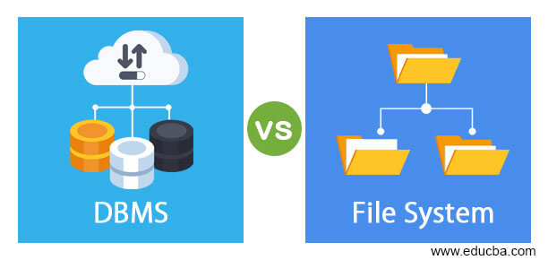
File system vs Database System

Slide 15
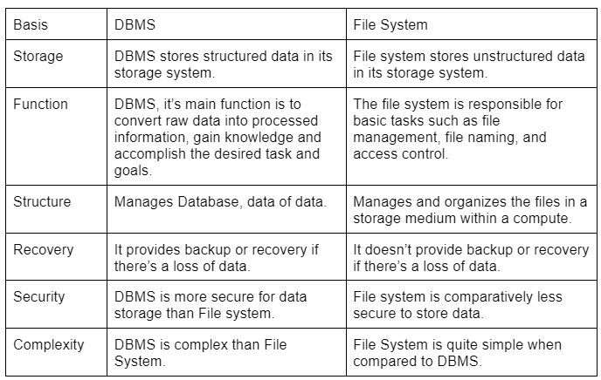

Slide 16
View of Data
Abstraction is one of the main features of database systems. Hiding irrelevant details from user and providing abstract view of data to users, helps in easy and efficient user-database interaction.
To fully understand the view of data, you must have a basic knowledge of data abstraction and instance & schema.
Data abstraction:
Database systems are made-up of complex data structures. To ease the user interaction with database, the developers hide internal irrelevant details from users. This process of hiding irrelevant details from user is called data abstraction.

Slide 17
2. Instance and schema:
Design of a database is called the schema. Schema is of three types: Physical schema, logical schema and view schema.
The data stored in database at a particular moment of time is called instance of database.
Database schema defines the variable declarations in tables that belong to a particular database; the value of these variables at a moment of time is called the instance of that database.

Slide 18
Data Abstraction
Database systems are made-up of complex data structures.
To ease the user interaction with database, the developers hide internal irrelevant details from users.
This process of hiding irrelevant details from user is called data abstraction.
The term “irrelevant” used here with respect to the user, it doesn’t mean that the hidden data is not relevant with regard to the whole database.
It just means that the user is not concerned about that data.

Slide 19
For example:
When you are booking a train ticket, you are not concerned how data is processing at the back end when you click “book ticket”, what processes are happening when you are doing online payments.
You are just concerned about the message that pops up when your ticket is successfully booked.
This doesn’t mean that the process happening at the back end is not relevant, it just means that you as a user are not concerned what is happening in the database.

Slide 20
Three levels of abstraction
Physical level/Internal level:
The physical or the internal level schema describes how the data is stored in the hardware. It also describes how the data can be accessed.
The physical level shows the data abstraction at the lowest level and it has complex data structures.
Only the database administrator operates at this level.

Slide 21
Logical level/Conceptual level:
This is the middle level of 3-level data abstraction architecture. It describes what data is stored in database.
It is a level above the physical level. Here, the data is stored in the form of the entity set, entities, their data types, the relationship among the entity sets, user operations performed to retrieve or modify the data and certain constraints on the data.
Well adding constraints to the view of data adds the security. As users are restricted to access some particular parts of the database.
It is the developer and database administrator who operates at the logical or the conceptual level.

Slide 22
View level/User level/ External level:
Highest level of data abstraction and exhibits only a part of the whole database.
This level describes the user interaction with database system.
The view level can describe many views of the same data.
Here, the user retrieves the information using different application from the database.

Slide 23
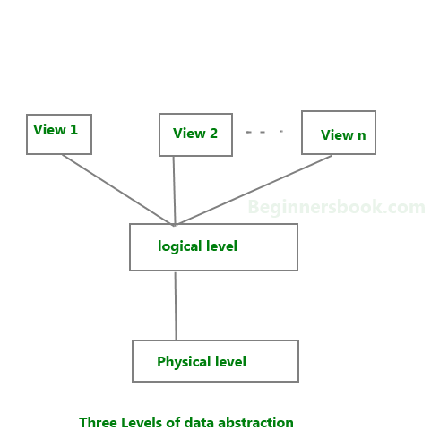

Slide 24
We have to create a database of a college. Now, what entity sets would be involved? Student, Lecturer, Department, Course and so on…
Now, the entity sets Student, Lecturer, Department, Course will be stored in the storage as the consecutive blocks of the memory location. This is the physical or internal level and is hidden from the programmers but the database administrator is it aware of it.
At the logical level, the programmers define the entity sets and relationship among these entity sets using a programming language like SQL. So, the programmers work at the logical level and even the database administrator also operates at this level.
At the view level, the users have the set of applications which they use to retrieve the data they are interested in.

Slide 25
Example: Let’s say we are storing customer information in a customer table. At physical level these records can be described as blocks of storage (bytes, gigabytes, terabytes etc.) in memory. These details are often hidden from the programmers.
At the logical level these records can be described as fields and attributes along with their data types, their relationship among each other can be logically implemented. The programmers generally work at this level because they are aware of such things about database systems.
At view level, user just interact with system with the help of GUI and enter the details at the screen, they are not aware of how the data is stored and what data is stored; such details are hidden from them.

Slide 26

Instance and schema in DBMS
DBMS Schema
Design of a database is called the schema. For example: An employee table in database exists with the following attributes:
This is the schema of the employee table. Schema defines the attributes of tables in the database.
Schema is of three types: Physical schema, logical schema and view schema.

Slide 27
Schema represents the logical view of the database. It helps you understand what data needs to go where.
Schema can be represented by a diagram as shown below.
Schema helps the database users to understand the relationship between data.
This helps in efficiently performing operations on database such as insert, update, delete, search etc.
In the following diagram, we have a schema that shows the relationship between three tables: Course, Student and Section.
The diagram only shows the design of the database, it doesn’t show the data present in those tables.
Schema is only a structural view(design) of a database as shown in the diagram below.

Slide 28
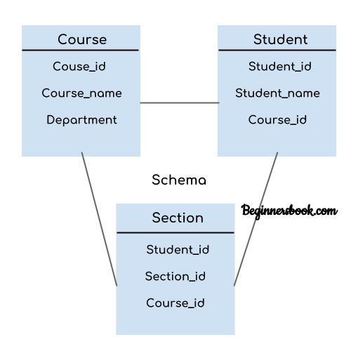



Slide 29
The design of a database at physical level is called physical schema, how the data stored in blocks of storage is described at this level.
Design of database at logical level is called logical schema, programmers and database administrators work at this level, at this level data can be described as certain types of data records gets stored in data structures, however the internal details such as implementation of data structure is hidden at this level (available at physical level).
Design of database at view level is called view schema. This generally describes end user interaction with database systems.

Slide 30
DBMS Instance
The data stored in database at a particular moment of time is called instance of database.
Database schema defines the attributes in tables that belong to a particular database.
The value of these attributes at a moment of time is called the instance of that database.
For example, we have seen the schema of table “employee” above. Let’s see the table with the data now. At this moment the table contains two rows (records). This is the current instance of the table “employee” because this is the data that is stored in this table at this particular moment of time.

Slide 31
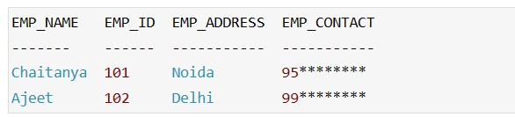
Let’s say we have a single table student in the database, today the table has 100 records, so today the instance of the database has 100 records.
We are going to add another 100 records in this table by tomorrow so the instance of database tomorrow will have 200 records in table.
In short, at a particular moment the data stored in database is called the instance, this changes over time as and when we add, delete or update data in the database.

Slide 32
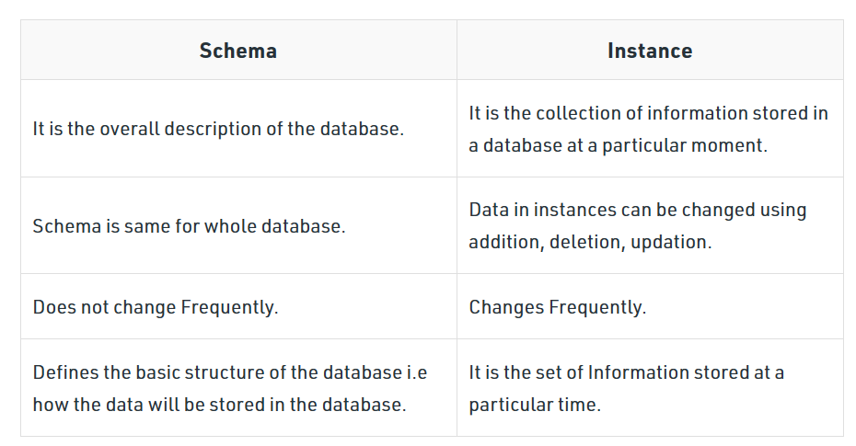

Slide 33
Data Models
Data Model is the modeling of the data description, data semantics, and consistency constraints of the data.
Data models in DBMS help to understand the design at the conceptual, physical, and logical levels as it provides a clear picture of the data making it easier for developers to create a physical database.
Data models are used to describe how the data is stored, accessed, and updated in a DBMS.
A set of symbols and text is used to represent them so that all the members of an organization can understand how the data is organized.
It provides a set of conceptual tools that are vastly used to represent the description of data.

Slide 34
Types of Data Models
1.Hierarchical Model
The hierarchical data model is one of the oldest data models, developed in the 1950s by IBM.
In this data model, the data is organized in a hierarchical tree-like structure.
This data model can be easily visualized because each record has one parent and many children (possibly 0) as shown in the image given below.

Slide 35
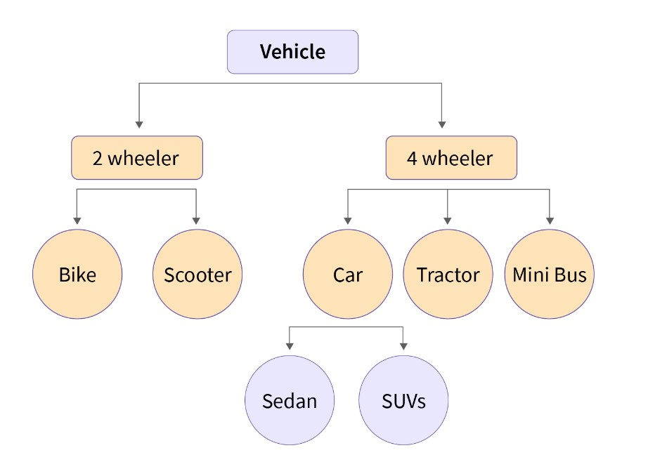

Slide 36
The above-given image represents the data model of the Vehicle database, vehicle are classified into two types Viz. two-wheelers and four-wheelers and then they are further classified.
The main drawback we can see here is we can only have one too many relationships under this model, hence the hierarchical data model is very rarely used nowadays.

Slide 37
2.Network Model
A network model is nothing but a generalization of the hierarchical data model as this data model allows many to many relationships therefore in this model a record can also have more than one parent.
The network model can be represented as a graph and hence it replaces the hierarchical tree with a graph in which object types are the nodes and relationships are the edges.
For example -

Slide 38
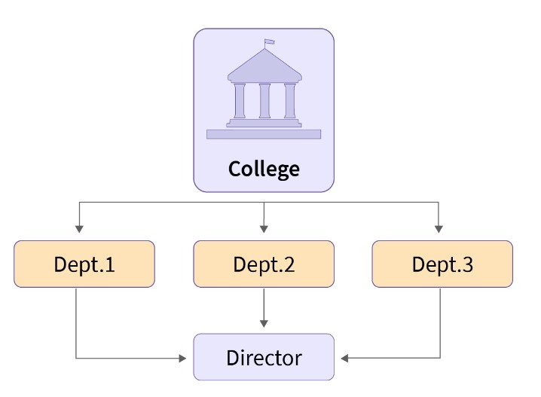

Slide 39
Here you can see all three departments are linked with the director which was not possible in the hierarchical data model.
In the network model, there can be many possible paths to reach a node from the root node (College is the root node in the above case), therefore the data can be accessed efficiently when compared to the hierarchical data model. But, on the other hand, the process of insertion and deletion of data is quite complex.

Slide 40
3.Entity-Relationship Model (ER Model)
An Entity-Relationship model is a high-level data model that describes the structure of the database in a pictorial form which is known as ER-diagram.
In simple words, an ER diagram is used to represent logical structure of the database easily.
ER model develops a conceptual view of the data hence it can be used as a blueprint to implement the database in the future.
Developers can easily understand the system just by looking at ER diagram. Let's first have a look at the components of an ER diagram.
Entity - Anything that has an independent existence about which we collect the data.

Slide 41
They are represented as rectangles in the ER diagram. For example - Car, house, employee.
Entity Set - A set of the same type of entities is known as an entity set. For example - Set of students studying in a college.
Attributes - Properties that define entities are called attributes. They are represented by an ellipse shape.
Relationships - A relationship is used to describe the association between entities. They are represented as diamond or rhombus shapes in the ER diagram.

Slide 42
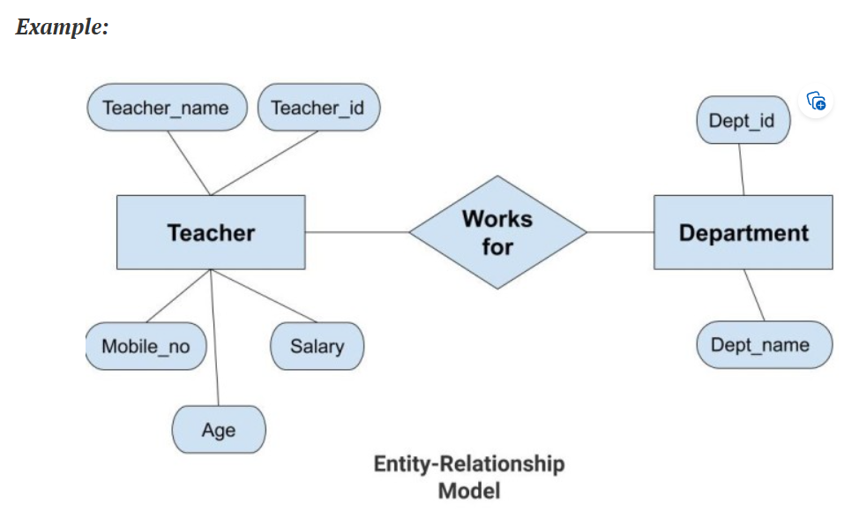


Slide 43
In the above diagram, the entities are Teacher and Department.
The attributes of Teacher entity are Teacher_Name, Teacher_id, Age, Salary, Mobile_Number. The attributes of entity Department entity are Dept_id, Dept_name.
The two entities are connected using the relationship. Here, each teacher works for a department.

Slide 44
4.Relational Model
This is the most widely accepted data model.
In this model, the database is represented as a collection of relations in the form of rows and columns of a two-dimensional table.
Each row is known as a tuple (a tuple contains all the data for an individual record) while each column represents an attribute.
For example -

Slide 45
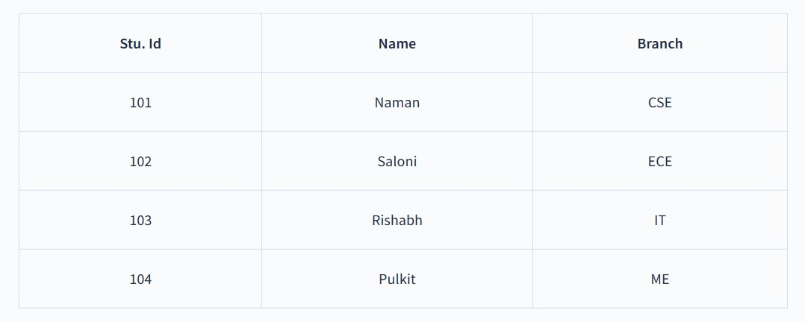
The above table shows a relation "STUDENT" with attributes such as Stu. Id, Name, and Branch which consists of 4 records or tuples.

Slide 46
5.Object-Oriented Data model
As suggested by its name, the object-oriented data model is a combination of object-oriented programming and relational data model.
In this data model, the data and their relationship are represented in a single structure which is known as an object.
Since data is stored as objects we can easily store audio, video, images, etc. in the database which was very difficult and inconvenient to do in the relational model.
As shown in the image below two objects are connected with each other through links.

Slide 47
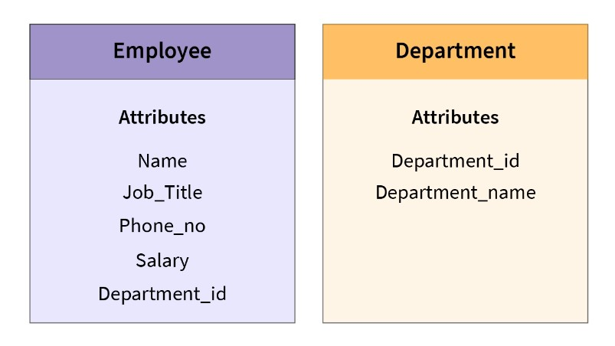
In the above image, we have two objects that are Employee and Department in which all the data is contained in a single unit (object). They are linked with each other as they share a common attribute i.e. Department_Id.

Slide 48
6.Object Relational Data Model
An Object relational model is a combination of a Object oriented database model and a Relational database model.
So, it supports objects, classes, inheritance etc. just like Object Oriented models and has support for data types, tabular structures etc. like Relational data model.
One of the major goals of Object relational data model is to close the gap between relational databases and the object oriented practices frequently used in many programming languages such as C++, C#, Java etc.
For example -

Slide 49
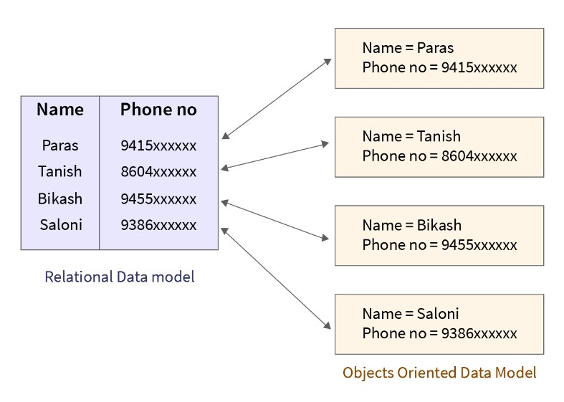

Slide 50
It provides data structures and operations used in the relational model and also provides features of object-oriented models like classes, inheritance, encapsulation etc.
The only drawback of this data model is that it is complex and quite difficult to handle.

Slide 51
7.Semi-Structured Data Model
A semi-structured data model is a generalized form of the relational model, which allows representing data in a flexible way, hence we can not differentiate between data and schema in this model because, in this model, some entities have a missing attribute(s) and on the other hand, some entities might have some extra attribute(s) which in turn makes it easy to update the schema of the database.
For example - We can say a data model is semi-structured if in some attributes we are storing both atomic values (values that can't be divided further, for example, Roll_No) as well as a collection of values.
HTML code, graphs and tables, e-mails, XML documents are examples of semi-structured data, which are often found in object-oriented databases.

Slide 52
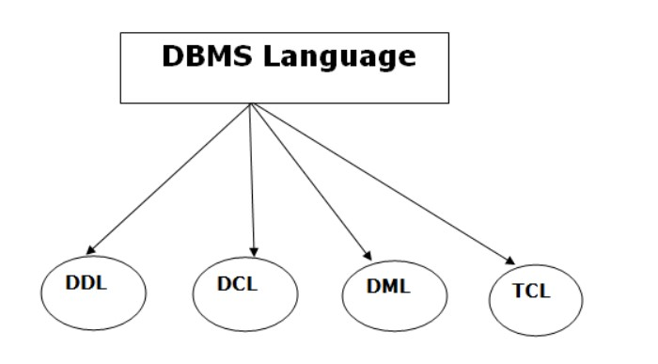
Database Languages/SQL Commands
A DBMS has appropriate languages and interfaces to express database queries and updates.
Database languages can be used to read, store and update the data in the database.
Types of Database Languages

Slide 53
Data Definition Language (DDL)
DDL stands for Data Definition Language. It is used to define database structure or pattern.
It is used to create schema, tables, indexes, constraints, etc. in the database.
Using the DDL statements, you can create the skeleton of the database.
Data definition language is used to store the information of metadata like the number of tables and schemas, their names, indexes, columns in each table, constraints, etc.
Here are some tasks that come under DDL:

Slide 54
Create: It is used to create objects in the database.
Alter: It is used to alter the structure of the database.
Drop: It is used to delete objects from the database.
Truncate: It is used to remove all records from a table.
Rename: It is used to rename an object.
Comment: It is used to comment on the data dictionary.
These commands are used to update the database schema that's why they come under Data definition language.

Slide 55
Data Manipulation Language (DML)
DML stands for Data Manipulation Language. It is used for accessing and manipulating data in a database. It handles user requests.
Here are some tasks that come under DML:
Select: It is used to retrieve data from a database.
Insert: It is used to insert data into a table.
Update: It is used to update existing data within a table.
Delete: It is used to delete all records from a table.
Merge: It performs UPSERT operation, i.e., insert or update operations.

Slide 56
Call: It is used to call a structured query language or a Java subprogram.
Explain Plan: It has the parameter of explaining data.
Lock Table: It controls concurrency.

Slide 57
Data Control Language (DCL)
DCL stands for Data Control Language. It is used to retrieve the stored or saved data.
The DCL execution is transactional. It also has rollback parameters. (But in Oracle database, the execution of data control language does not have the feature of rolling back.)
Here are some tasks that come under DCL:
Grant: It is used to give user access privileges to a database.
Revoke: It is used to take back permissions from the user.
There are the following operations which have the authorization of Revoke:
CONNECT, INSERT, USAGE, EXECUTE, DELETE, UPDATE and SELECT.

Slide 58
Transaction Control Language (TCL)
TCL is used to run the changes made by the DML statement. TCL can be grouped into a logical transaction.
Here are some tasks that come under TCL:
Commit: It is used to save the transaction on the database.
Rollback: It is used to restore the database to original since the last Commit.
Savepoint: It is used to temporarily save a transaction so that you can rollback to that point whenever required.

Slide 59
Database Users
In simple terms, if we understand, any person who uses a database and avails benefits from the database is known as database user in DBMS.
Database users in DBMS can access the database and retrieve the data from the database using applications and interfaces provided by the Database Management System (DBMS).
We can always provide security to our database from being accessed by the unauthorized users.
Different database users with different login IDs and passwords can only have unrestricted access to that part of the database with which they are associated as per the requirements.
Database users in DBMS can be categorized based on their interaction with the databases.
According to the tasks performed by the database users on the databases, we can categorize them into seven categories as follows:

Slide 60
Database Administrators (DBA)
Database Designers
System Analysts
Application Programmers / Back-End Developers
Naive Users / Parametric Users
Sophisticated Users
Casual Users / Temporary Users

Slide 61
Database Administrators (DBA)
Database Administrator (DBA) is a person/team who defines the schema and also controls the 3 levels of database.
The DBA will then create a new account id and password for the user if he/she need to access the database.
DBA is also responsible for providing security to the database and he allows only the authorized users to access/modify the data base.
DBA is responsible for the problems such as security breaches and poor system response time.
DBA also monitors the recovery and backup and provide technical support.

Slide 62
The DBA has a DBA account in the DBMS which called a system or superuser account.
DBA repairs damage caused due to hardware and/or software failures.
DBA is the one having privileges to perform DCL (Data Control Language) operations such as GRANT and REVOKE, to allow/restrict a particular user from accessing the database.

Slide 63
Database Designers
Data Base Designers are the users who design the structure of database which includes tables, indexes, views, triggers, stored procedures and constraints which are usually enforced before the database is created or populated with data.
He/she controls what data must be stored and how the data items to be related.
It is responsibility of Database Designers to understand the requirements of different user groups and then create a design which satisfies the need of all the user groups.

Slide 64
Naive Users / Parametric Users
Naive users also known as Parametric End users, don't have any knowledge of DBMS but still frequently use the database applications to get the desired results.
Parametric End Users are the unsophisticated who don’t have any DBMS knowledge but they frequently use the database applications in their daily life to get the desired results.
For examples, Railway’s ticket booking users are naive users. Clerks in any bank is a naive user because they don’t have any DBMS knowledge but they still use the database and perform their given task.

Slide 65
System Analyst
System Analysts are the type of database users in DBMS who analyze the requirements of Naive / Parametric End users.
It is their responsibility to check whether all the requirements of end users are satisfied or not.
Analyzing feasibility, economic and technical aspects are some of the major responsibilities for a system analyst in DBMS. Sometimes, they are also responsible for the design, structure & functioning of the database.
They usually check and gather all the necessary information related to the database, and if needed, they can change or update the final layout of the database as per requirements. System Analysts always make sure that the final product should meet all the requirements.

Slide 66
Application Programmers / Back-End Developers
Application Programmers also known as Back-End Developers, are computer professional users who are responsible for developing the application programs (C, C++, Java, PHP, Python, etc.) or the user interface so that other users can use these applications to interact with the database.
Application Programmers have deep knowledge of DBMS & databases and know everything in detail.
They interact with the database using DML (Data Manipulation Language) queries to store data inside the database and when needed, they can also fetch the data from it.
When needed, Application Programmers also specify the modifications needed in the database structure for an application.
They are efficient enough in designing or developing their database in any language they know.

Slide 67
Sophisticated Users
Sophisticated users are the type of database users in DBMS who know DBMS (DDL & DML commands) and are familiar with the database.
Sophisticated users can be business analysts, engineers, scientists, system analysts, etc.
Sophisticated users can develop or access their database applications according to the requirements, without actually writing the program code for it.
These users are also known as SQL programmers as they can interact with the database directly using SQL queries using query processors.
Using SQL queries, they can fetch the data from the database. They can also delete, update or insert new data into the database.
For example: Data Engineers & Developers who are familiar with the database, directly access the database using SQL queries rather than writing programming code for accessing the database again. Hence, they are termed as sophisticated users.

Slide 68
Casual Users / Temporary Users
Casual users also known as temporary users, are the type of database users in DBMS who frequently or occasionally use the database services.
Whenever these users try to access the database, they want all the information sorted in place.
Casual/Temporary users have little knowledge about DBMS and each time they try to access the database, they require new information.
For example: High-level management people are casual users who have little knowledge about DBMS and hence, they can access the database to either fill in new information or retrieve existing results.

Slide 69
DBMS architecture
The DBMS design depends upon its architecture. The basic client/server architecture is used to deal with a large number of PCs, web servers, database servers and other components that are connected with networks.
The client/server architecture consists of many PCs and a workstation which are connected via the network.
DBMS architecture depends upon how users are connected to the database to get their request done.

Slide 70
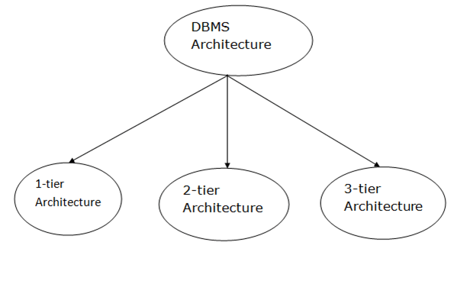
Database architecture can be seen as a single tier or multi-tier. But logically, database architecture is of two types like: 2-tier architecture and 3-tier architecture.

Slide 71
1-Tier Architecture
In One-Tier Architecture the database is directly available to the user, the user can directly sit on the DBMS and use it i.e.; the client, server, and the Database are all present on the same machine.
For Example- To learn SQL we set up an SQL server and the database on the local system.
This enables us to directly interact with the relational database and execute operations.
The industry won’t use this architecture they logically go for 2-Tier and 3-Tier Architecture.

Slide 72
2-Tier Architecture
The two-tier architecture is similar to a basic client-server model.
The application at the client end directly communicates with the database at the server side.
APIs like ODBC and JDBC are used for this interaction. The server side is responsible for providing query processing and transaction management functionalities.
On the client side, the user interfaces and application programs are run. The application on the client side establishes a connection with the server side in order to communicate with the DBMS.
An advantage of this type is that maintenance and understanding are easier, and compatible with existing systems.
However, this model gives poor performance when there are a large number of users.

Slide 73
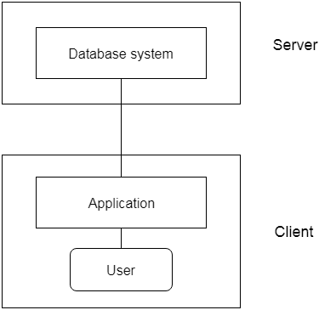

Slide 74
3-Tier Architecture
In this type, there is another layer between the client and the server. The client does not directly communicate with the server.
Instead, it interacts with an application server which further communicates with the database system and then the query processing and transaction management takes place.
This intermediate layer acts as a medium for the exchange of partially processed data between server and client.
This type of architecture is used in the case of large web applications.

Slide 75
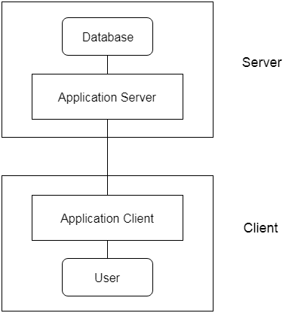

Slide 76
Advantages:
Enhanced scalability due to distributed deployment of application servers. Now, individual connections need not be made between client and server.
Data Integrity is maintained. Since there is a middle layer between the client and the server, data corruption can be avoided/removed.
Security is improved. This type of model prevents direct interaction of the client with the server thereby reducing access to unauthorized data.
Disadvantages:
Increased complexity of implementation and communication. It becomes difficult for this sort of interaction to take place due to the presence of middle layers.

Slide 77
ER model
ER model stands for an Entity-Relationship model.
It is a high-level data model. This model is used to define the data elements and relationship for a specified system.
It develops a conceptual design for the database. It also develops a very simple and easy to design view of data.
In ER modeling, the database structure is portrayed as a diagram called an entity-relationship diagram.
For example, Suppose we design a school database. In this database, the student will be an entity with attributes like address, name, id, age, etc. The address can be another entity with attributes like city, street name, pin code, etc and there will be a relationship between them.

Slide 78
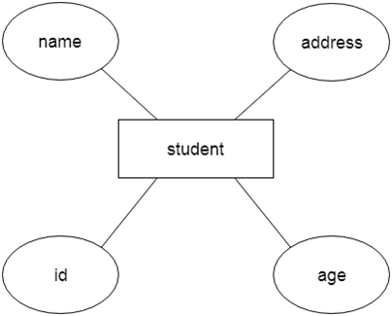

Slide 79
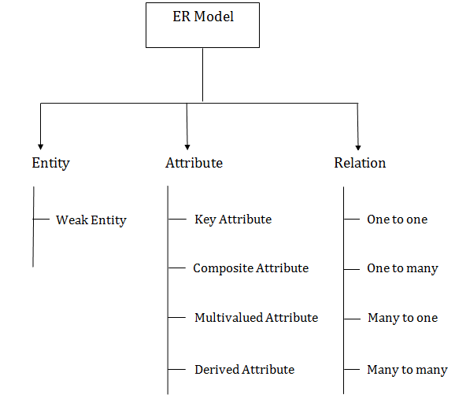
Component of ER Diagram

Slide 80

Entity:
An entity may be any object, class, person or place. In the ER diagram, an entity can be represented as rectangles.
Consider an organization as an example- manager, product, employee, department etc. can be taken as an entity.

Slide 81
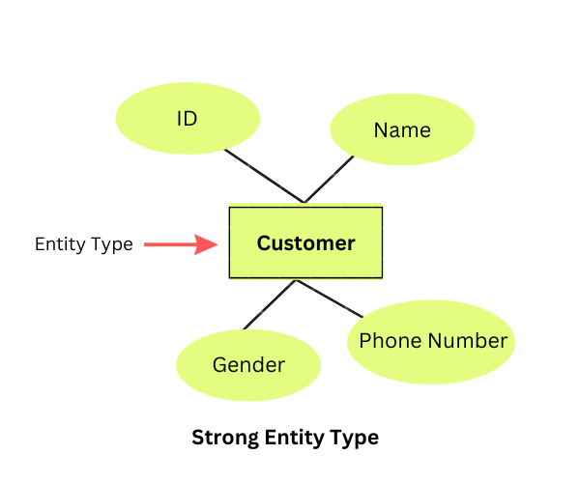
a. Strong Entity:
A strong entity is an entity that is not dependent on any other entity.
It has a primary key, or a table includes a primary key.
It is an entity that has its own existence and is independent.
In the above example, the "Customer" is the entity type with attributes such as ID, Name, Gender, and Phone Number. Customer is a strong entity type as it has a unique ID for each customer.

Slide 82
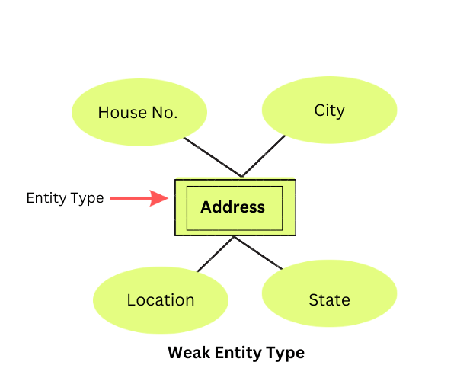
b. Weak Entity
An entity that depends on another entity called a weak entity.
The weak entity doesn't contain any key attribute of its own.
The weak entity is represented by a double rectangle.
In the above example, "Address" is a weak entity type with attributes such as House No., City, Location, and State.

Slide 83
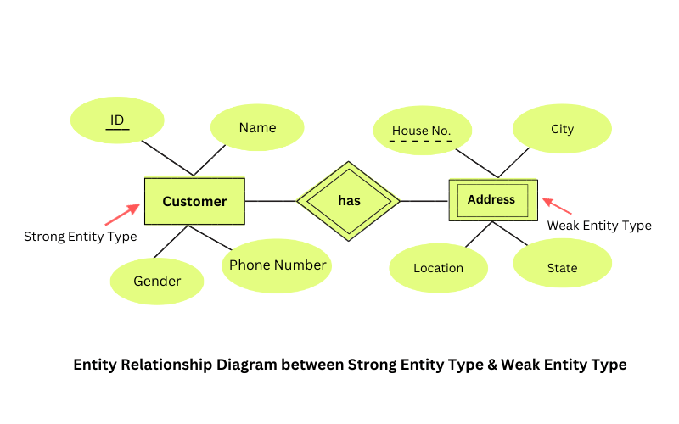
Let us see an example of the relationship between the Strong entity type and weak entity type with the help of ER Diagram:

Slide 84
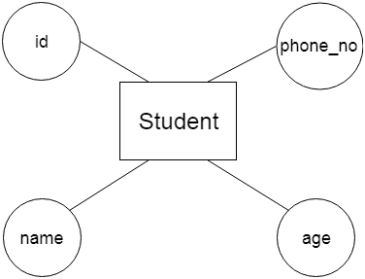
2. Attribute
The attribute is used to describe the property of an entity. Ellipse is used to represent an attribute.
For example, id, age, contact number, name, etc. can be attributes of a student.

Slide 85
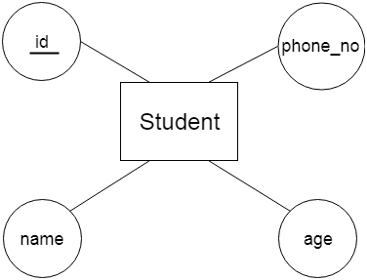
a. Key Attribute
The key attribute is used to represent the main characteristics of an entity.
It represents a primary key. The key attribute is represented by an ellipse with the text underlined.

Slide 86
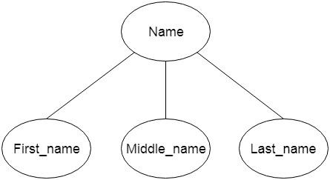
b. Composite Attribute
An attribute that composed of many other attributes is known as a composite attribute.
The composite attribute is represented by an ellipse, and those ellipses are connected with an ellipse.

Slide 87
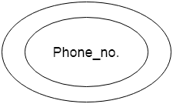
c. Multivalued Attribute
An attribute can have more than one value.
These attributes are known as a multivalued attribute. The double oval is used to represent multivalued attribute.
For example, a student can have more than one phone number.

Slide 88
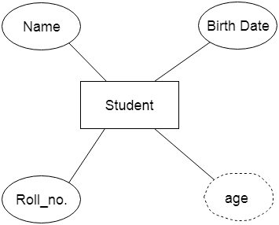
d. Derived Attribute
An attribute that can be derived from other attribute is known as a derived attribute.
It can be represented by a dashed ellipse.
For example, A person's age changes over time and can be derived from another attribute like Date of birth.

Slide 89

3. Relationship
A relationship is used to describe the relation between entities.
Diamond or rhombus is used to represent the relationship.

Slide 90
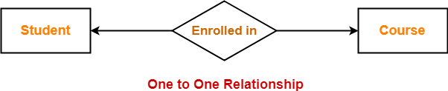
Types of relationship are as follows:
One-to-One Relationship
When only one instance of an entity is associated with the relationship, then it is known as one to one relationship

Slide 91

b. One-to-many relationship
When only one instance of the entity on the left, and more than one instance of an entity on the right associates with the relationship then this is known as a one-to-many relationship.
For example, Scientist can invent many inventions, but the invention is done by the only specific scientist.

Slide 92

c. Many-to-one relationship
When more than one instance of the entity on the left, and only one instance of an entity on the right associates with the relationship then it is known as a many-to-one relationship.
For example, Student enrolls for only one course, but a course can have many students.

Slide 93

d. Many-to-many relationship
When more than one instance of the entity on the left, and more than one instance of an entity on the right associates with the relationship then it is known as a many-to-many relationship.
For example, Employee can assign by many projects and project can have many employees.

Slide 94
Relational model:
The relational Model was proposed by E.F. Codd to model data in the form of relations or tables.
After designing the conceptual model of the Database using ER diagram, we need to convert the conceptual model into a relational model which can be implemented using any RDBMS language like Oracle SQL, MySQL, etc.
The relational model represents how data is stored in Relational Databases.
A relational database stores data in the form of relations (tables).
Relational Model (RM) represents the database as a collection of relations.
A relation is nothing but a table of values.
Every row in the table represents a collection of related data values. These rows in the table denote a real-world entity or relationship.

Slide 95
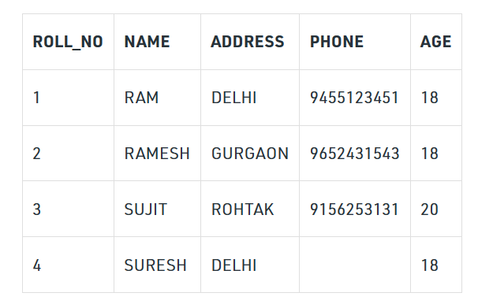
Consider a relation STUDENT with attributes ROLL_NO, NAME, ADDRESS, PHONE, and AGE shown in Table 1.

Slide 96

Relational Model Concepts in DBMS
Attribute: Each column in a Table. Attributes are the properties which define a relation. e.g., Student_Rollno, NAME,etc.
Tables – In the Relational model the, relations are saved in the table format. It is stored along with its entities. A table has two properties rows and columns. Rows represent records and columns represent attributes.
Tuple – It is nothing but a single row of a table, which contains a single record. The above relation contains 4 tuples, one of which is shown as:
4.Relation Schema: A relation schema represents the name of the relation with its attributes.
e.g.; STUDENT (ROLL_NO, NAME, ADDRESS, PHONE, and AGE) is the relation schema for STUDENT. If a schema has more than 1 relation, it is called Relational Schema.

Slide 97
5.Degree: The total number of attributes which in the relation is called the degree of the relation. The STUDENT relation defined above has degree 5.
6.Cardinality: The number of tuples in a relation is known as cardinality. The STUDENT relation defined above has cardinality 4.
7.Column: The column represents the set of values for a specific attribute.
8.Relation instance – Relation instance is a finite set of tuples in the RDBMS system. Relation instances never have duplicate tuples.
9.Relation key – Every row has one, two or multiple attributes, which is called relation key.
10.Attribute domain – Every attribute has some pre-defined value and scope which is known as attribute domain
11. NULL Values: The value which is not known or unavailable is called a NULL value. It is represented by blank space. e.g.; PHONE of STUDENT having ROLL_NO 4 is NULL.

Slide 98
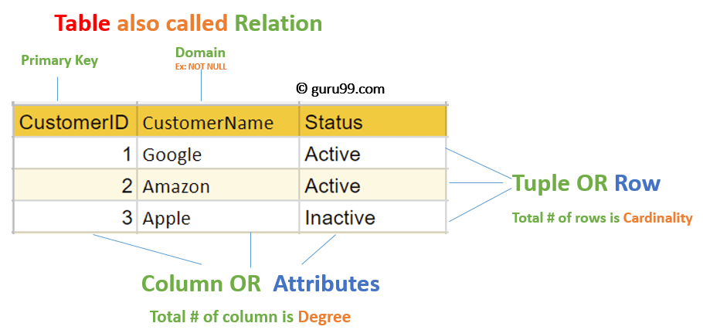

Slide 99
Constraints Relational Model
While designing the Relational Model, we define some conditions which must hold for data present in the database are called Constraints.
These constraints are checked before performing any operation (insertion, deletion, and updation ) in the database.
If there is a violation of any of the constraints, the operation will fail.
There are many types of Integrity Constraints in DBMS. Constraints on the Relational database management system is mostly divided into three main categories are:
Domain Constraints
Key Constraints
Referential Integrity Constraints

Slide 100
Domain Constraints
These are attribute-level constraints.
An attribute can only take values that lie inside the domain range.
e.g; If a constraint AGE>0 is applied to STUDENT relation, inserting a negative value of AGE will result in failure.

Slide 101
Key Integrity:
Every relation in the database should have at least one set of attributes that defines a tuple uniquely.
Those set of attributes is called keys. e.g.; ROLL_NO in STUDENT is a key.
No two students can have the same roll number. So a key has two properties:
It should be unique for all tuples.
It can’t have NULL values.

Slide 102
Referential Integrity Constraints
When one attribute of a relation can only take values from another attribute of the same relation or any other relation, it is called referential integrity.
Referential Integrity constraints in DBMS are based on the concept of Foreign Keys.
A foreign key is an important attribute of a relation which should be referred to in other relationships.
Referential integrity constraint state happens where relation refers to a key attribute of a different or same relation. However, that key element must exist in the table.
Example:

Slide 103
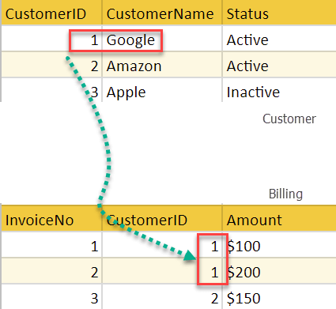
In the above example, we have 2 relations, Customer and Billing.
Tuple for CustomerID =1 is referenced twice in the relation Billing.
So we know CustomerName=Google has billing amount $300

Slide 104
Operations in Relational Model
Four basic update operations performed on relational database model are
Insert, update, delete and select.
Insert is used to insert data into the relation
Delete is used to delete tuples from the table.
Modify allows you to change the values of some attributes in existing tuples.
Select allows you to choose a specific range of data.
Whenever one of these operations are applied, integrity constraints specified on the relational database schema must never be violated.

Slide 105
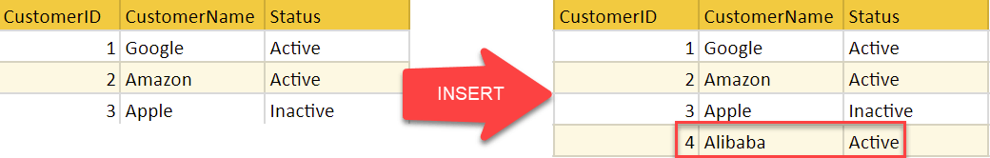
Insert Operation
The insert operation gives values of the attribute for a new tuple which should be inserted into a relation.

Slide 106
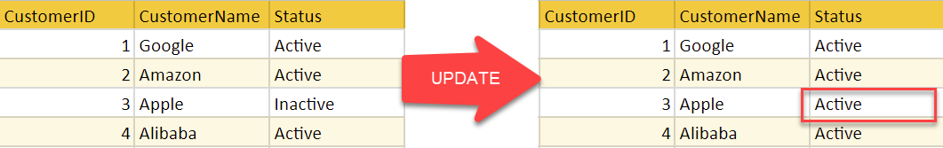
Update Operation
You can see that in the below-given relation table CustomerName= ‘Apple’ is updated from Inactive to Active.

Slide 107
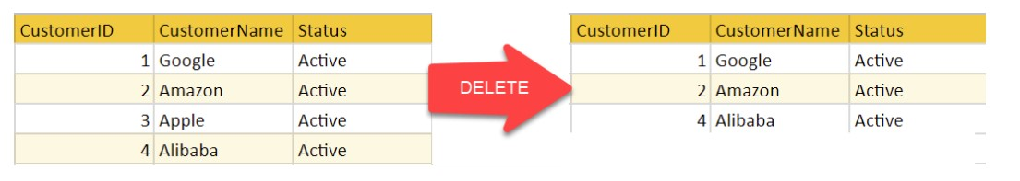
Delete Operation
To specify deletion, a condition on the attributes of the relation selects the tuple to be deleted.

Slide 108
In the above-given example, CustomerName= “Apple” is deleted from the table.
The Delete operation could violate referential integrity if the tuple which is deleted is referenced by foreign keys from other tuples in the same database.

Slide 109
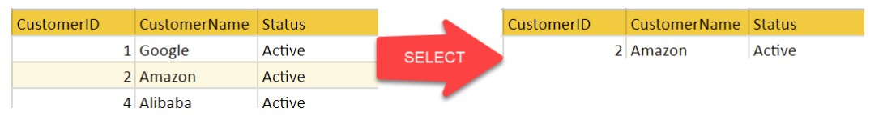
Select Operation
In the above-given example, CustomerName=”Amazon” is selected

Slide 110
Advantages of Relational Database Model
Simplicity: A Relational data model in DBMS is simpler than the hierarchical and network model.
Structural Independence: The relational database is only concerned with data and not with a structure. This can improve the performance of the model.
Easy to use: The Relational model in DBMS is easy as tables consisting of rows and columns are quite natural and simple to understand
Query capability: It makes possible for a high-level query language like SQL to avoid complex database navigation.
Data independence: The Structure of Relational database can be changed without having to change any application.
Scalable: Regarding a number of records, or rows, and the number of fields, a database should be enlarged to enhance its usability.

Slide 111
Disadvantages of Relational Model
Few relational databases have limits on field lengths which can’t be exceeded.
Relational databases can sometimes become complex as the amount of data grows, and the relations between pieces of data become more complicated.
Complex relational database systems may lead to isolated databases where the information cannot be shared from one system to another.

Slide 112
Types of keys in relational model
Keys are one of the basic requirements of a relational database model.
It is widely used to identify the tuples(rows) uniquely in the table.
We also use keys to set up relations amongst various columns and tables of a relational database.
Different Types of Keys in the Relational Model
Candidate Key
Primary Key
Super Key
Alternate Key
Foreign Key
Composite Key

Slide 113
.
1. Candidate Key: The minimal set of attributes that can uniquely identify a tuple is known as a candidate key. For Example, STUD_NO in STUDENT relation.
It is a minimal super key. It is a super key with no repeated data is called a candidate key.
The minimal set of attributes that can uniquely identify a record.
It must contain unique values.
It can contain NULL values.
Every table must have at least a single candidate key.
A table can have multiple candidate keys but only one primary key (the primary key cannot have a NULL value, so the candidate key with a NULL value can’t be the primary key).
The value of the Candidate Key is unique and may be null for a tuple.
There can be more than one candidate key in a relationship.
Example: STUD_NO is the candidate key for relation STUDENT

Slide 114
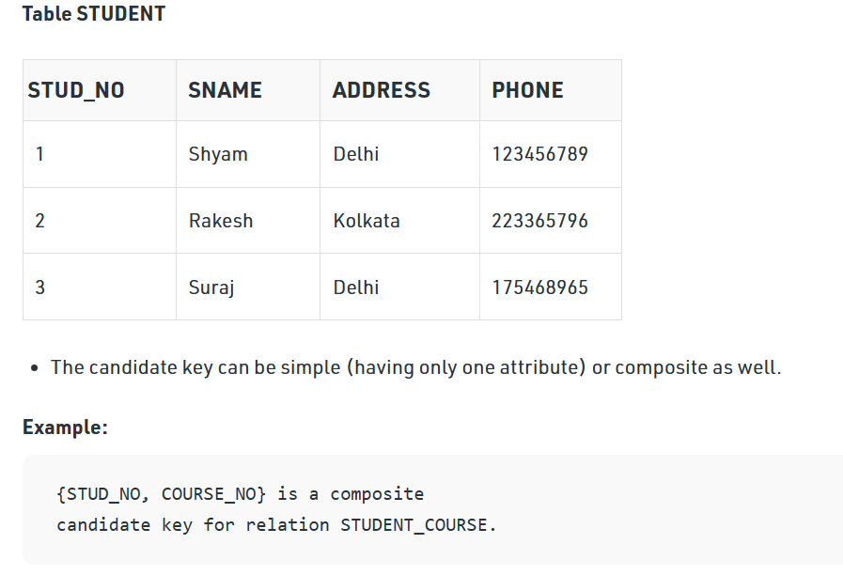
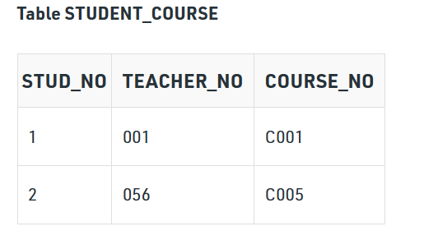

Slide 115
2. Primary Key: There can be more than one candidate key in relation out of which one can be chosen as the primary key. For Example, STUD_NO, as well as STUD_PHONE, are candidate keys for relation STUDENT but STUD_NO can be chosen as the primary key (only one out of many candidate keys).
It is a unique key.
It can identify only one tuple (a record) at a time.
It has no duplicate values, it has unique values.
It cannot be NULL.
Primary keys are not necessarily to be a single column; more than one column can also be a primary key for a table.

Slide 116
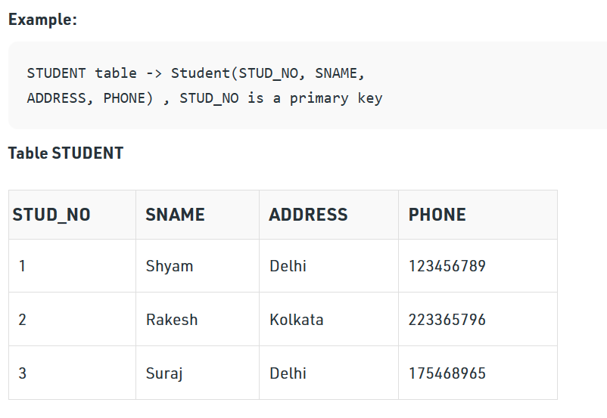

Slide 117
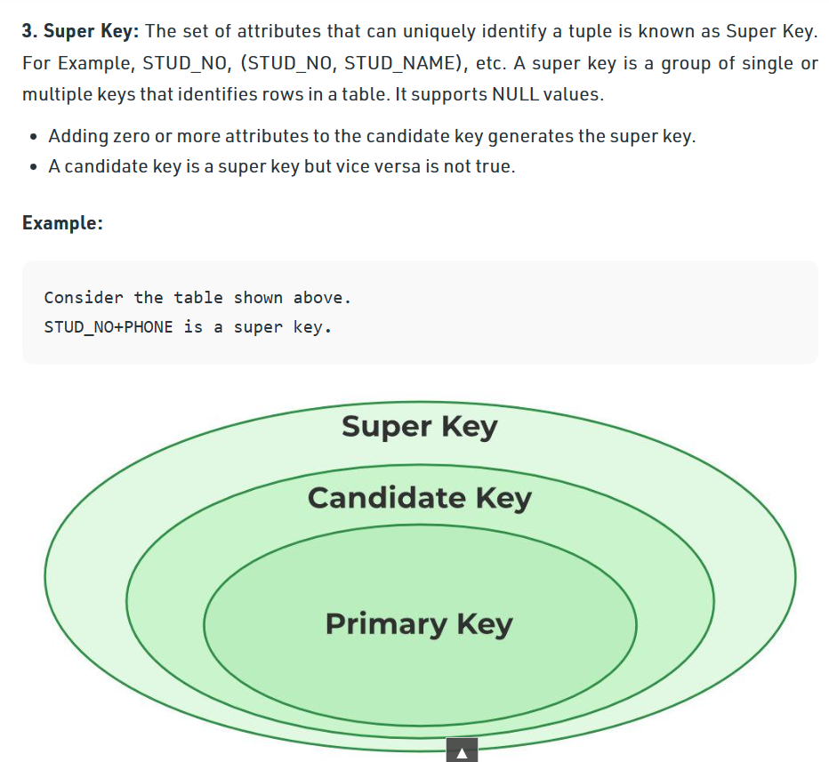

Slide 118
4. Alternate Key: The candidate key other than the primary key is called an alternate key.
All the keys which are not primary keys are called alternate keys.
It is a secondary key.
It contains two or more fields to identify two or more records.
These values are repeated.
Eg:- SNAME, and ADDRESS is Alternate keys

Slide 119
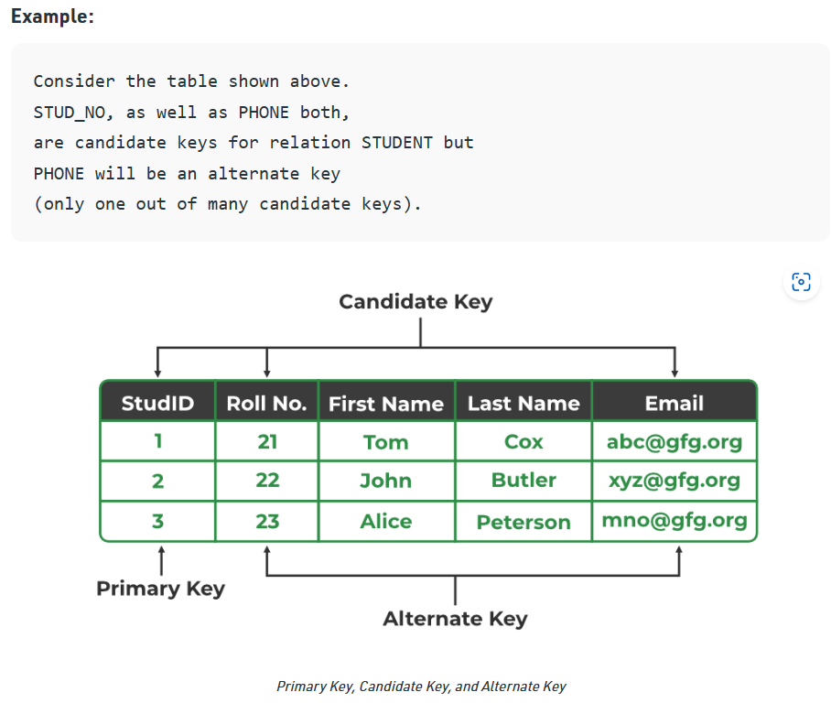

Slide 120
5. Foreign Key: If an attribute can only take the values which are present as values of some other attribute, it will be a foreign key to the attribute to which it refers.
The relation which is being referenced is called referenced relation and the corresponding attribute is called referenced attribute the relation which refers to the referenced relation is called referencing relation and the corresponding attribute is called referencing attribute.
The referenced attribute of the referenced relation should be the primary key to it.
It is a key it acts as a primary key in one table and it acts as secondary key in another table.
It combines two or more relations (tables) at a time.
They act as a cross-reference between the tables.
For example, DNO is a primary key in the DEPT table and a non-key in EMP

Slide 121
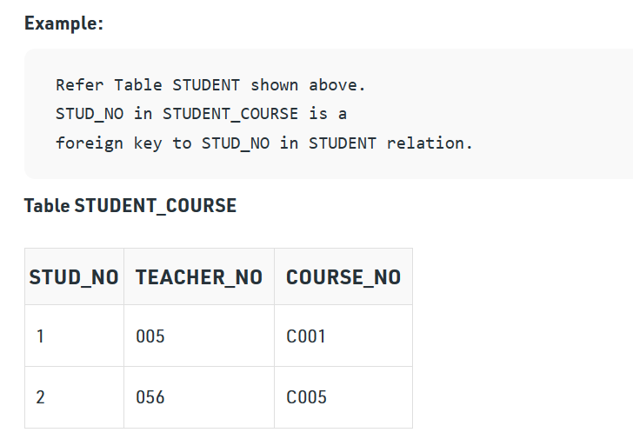

Slide 122
It may be worth noting that, unlike the Primary Key of any given relation, Foreign Key can be NULL as well as may contain duplicate tuples i.e. it need not follow uniqueness constraint.
For Example, STUD_NO in the STUDENT_COURSE relation is not unique.
It has been repeated for the first and third tuples. However, the STUD_NO in STUDENT relation is a primary key and it needs to be always unique, and it cannot be null.

Slide 123
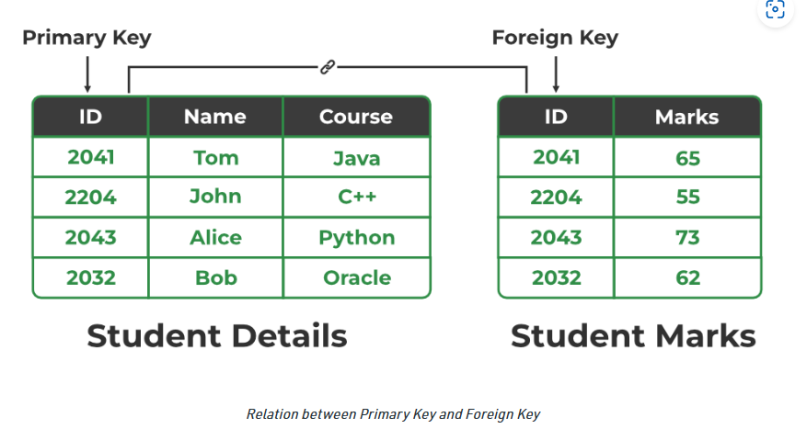

Slide 124
6. Composite Key: Sometimes, a table might not have a single column/attribute that uniquely identifies all the records of a table.
To uniquely identify rows of a table, a combination of two or more columns/attributes can be used.
It still can give duplicate values in rare cases. So, we need to find the optimal set of attributes that can uniquely identify rows in a table.
It acts as a primary key if there is no primary key in a table
Two or more attributes are used together to make a composite key.
Different combinations of attributes may give different accuracy in terms of identifying the rows uniquely.

Slide 125
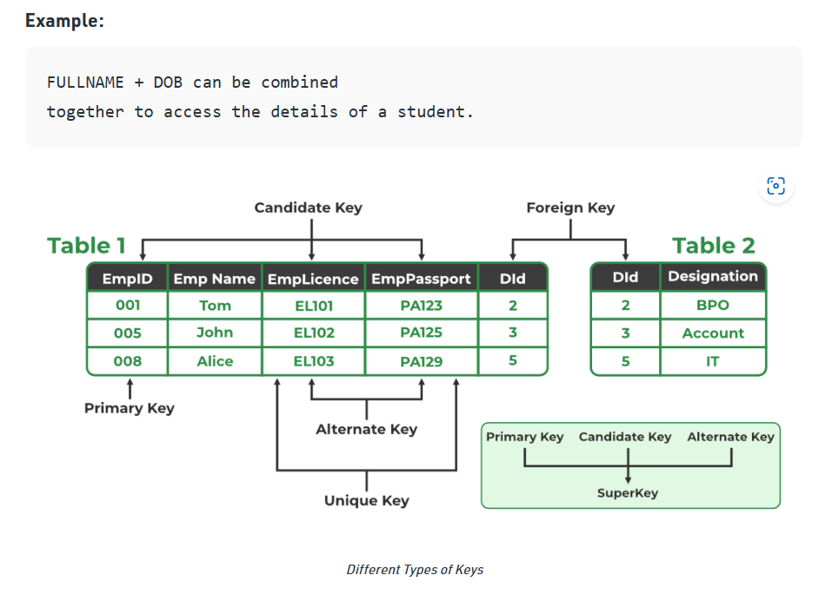


Slide 126
Anomalies in Relational model
Anomalies in the relational model refer to inconsistencies or errors that can arise when working with relational databases, specifically in the context of data insertion, deletion, and modification.
There are different types of anomalies that can occur in referencing and referenced relations which can be discussed as:
These anomalies can be categorized into three types:
Insertion Anomalies
Deletion Anomalies
Update Anomalies.

Slide 127
How Are Anomalies Caused in DBMS?
Database anomalies are the faults in the database caused due to poor management of storing everything in the flat database.
It can be removed with the process of Normalization, which generally splits the database which results in reducing the anomalies in the database.

Slide 128
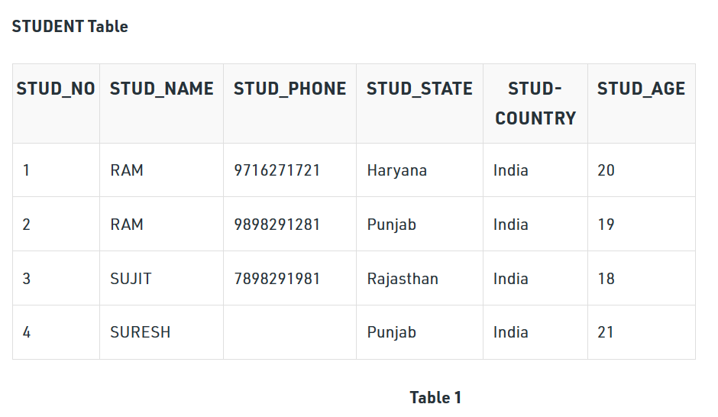
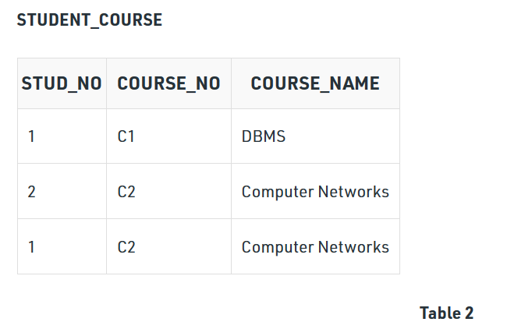

Slide 129
Insertion anomaly: If a tuple is inserted in referencing relation and referencing attribute value is not present in referenced attribute, it will not allow insertion in referencing relation.
Example: If we try to insert a record in STUDENT_COURSE with STUD_NO =7, it will not allow it.
Deletion and Updation anomaly: If a tuple is deleted or updated from referenced relation and the referenced attribute value is used by referencing attribute in referencing relation, it will not allow deleting the tuple from referenced relation.
Example: If we want to update a record from STUDENT_COURSE with STUD_NO =1, We have to update it in both rows of the table. If we try to delete a record from STUDENT with STUD_NO =1, it will not allow it.
To avoid this, the following can be used in query:

Slide 130
ON DELETE/UPDATE SET NULL: If a tuple is deleted or updated from referenced relation and the referenced attribute value is used by referencing attribute in referencing relation, it will delete/update the tuple from referenced relation and set the value of referencing attribute to NULL.
ON DELETE/UPDATE CASCADE: If a tuple is deleted or updated from referenced relation and the referenced attribute value is used by referencing attribute in referencing relation, it will delete/update the tuple from referenced relation and referencing relation as well.

Slide 131
How these Anomalies Occur
Insertion Anomalies: These anomalies occur when it is not possible to insert data into a database because the required fields are missing or because the data is incomplete. For example, if a database requires that every record has a primary key, but no value is provided for a particular record, it cannot be inserted into the database.
Deletion anomalies: These anomalies occur when deleting a record from a database and can result in the unintentional loss of data. For example, if a database contains information about customers and orders, deleting a customer record may also delete all the orders associated with that customer.
Update anomalies: These anomalies occur when modifying data in a database and can result in inconsistencies or errors. For example, if a database contains information about employees and their salaries, updating an employee’s salary in one record but not in all related records could lead to incorrect calculations and reporting.

